Slide 1


Slide 2


TEAM MEMBERS
->Avinash Kumar
->Uttam Soren
->Jainendra Kumar
->Ravi Kumar
->Syed Shahrukh Ahmad
Under the Guidance of
Mr. Arun Kumar Mishra

Slide 3
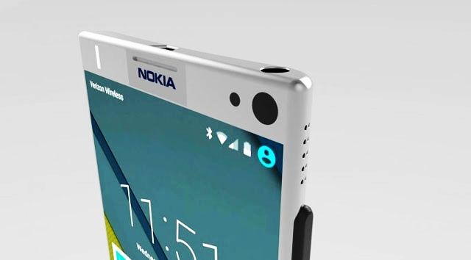
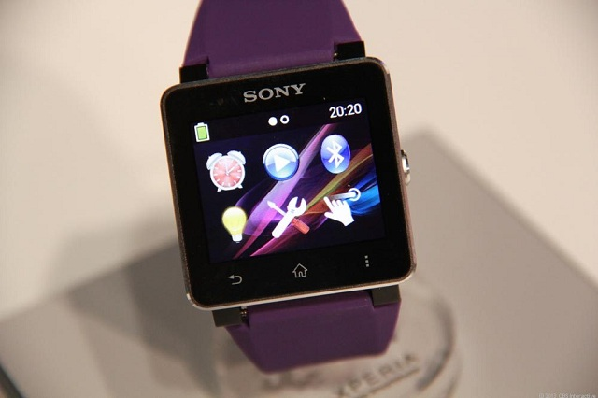
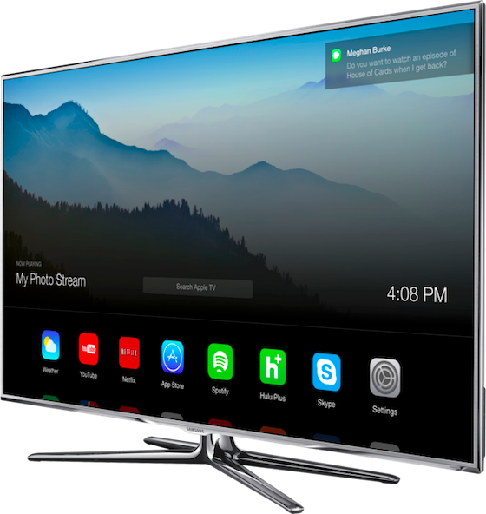
What is Android?
→ Android is an open source Linux-based Operating System for mobile devices such as smart-phones and tablet computers.
→ Like other computer operating systems Android offers unified approach to application development (but in mobile devices). That means developers need to develop applications for Android, and it should run on different devices powered by Android.
→ Powers smart-phones, smart-watches, Smart-tv’s and even cars too.

Slide 4
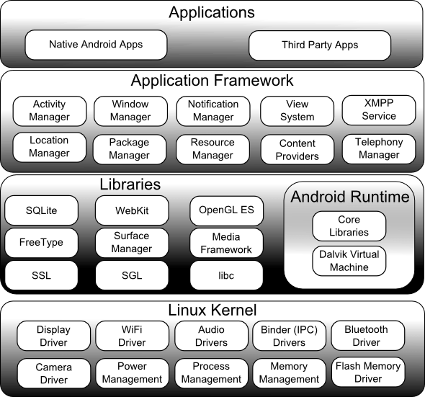
THE ANDROID ARCHITECURE

Slide 5
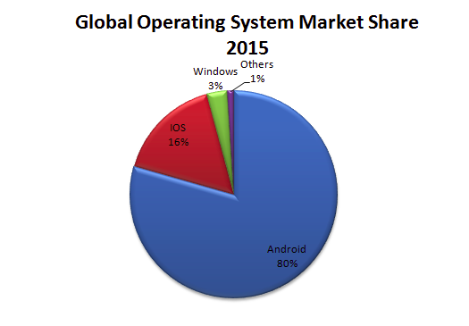
Why Android App Development is worth it?
Android continues to lead the Global market share, having reach on over 80% of mobile users

Slide 6
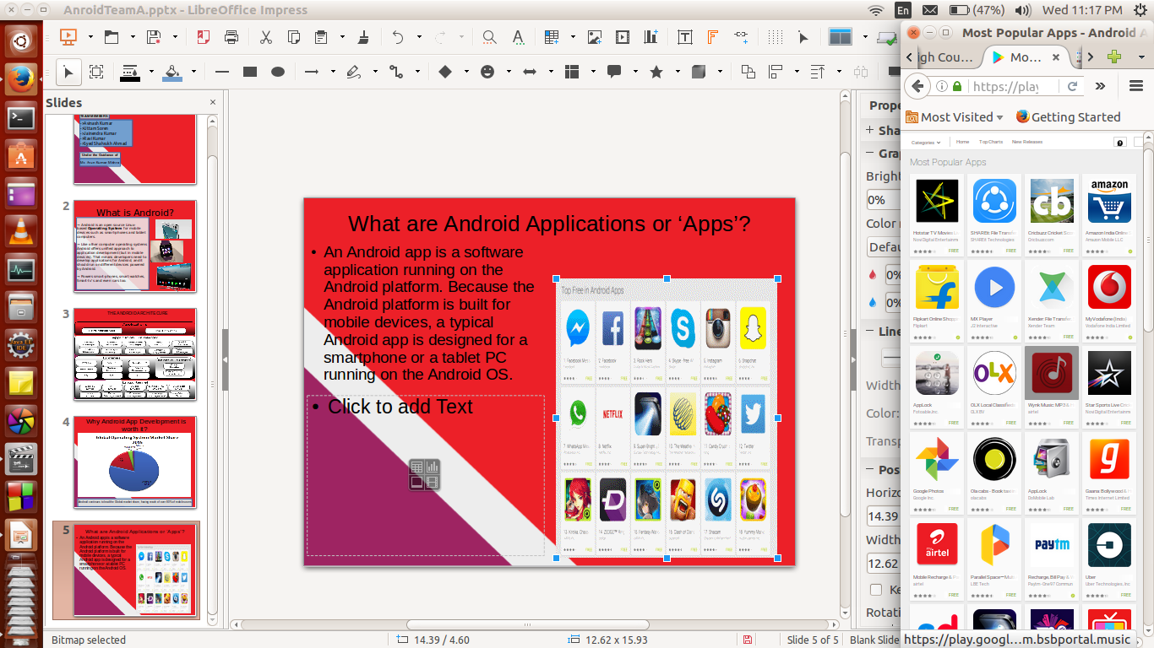
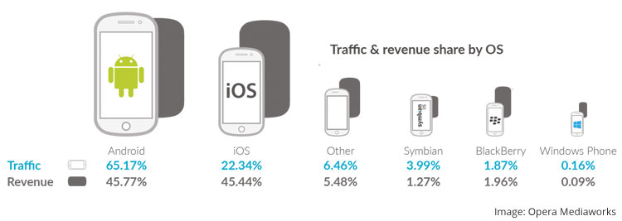
What are Android Applications or ‘Apps’?
An Android app is a software application running on the Android platform. Because the Android platform is built for mobile devices, a typical Android app is designed for a smartphone or a tablet PC running on the Android OS.

Slide 7


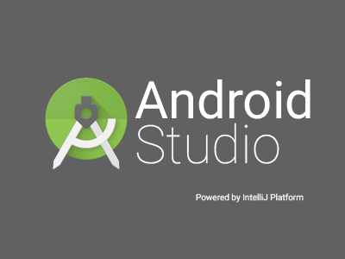
Tools and Softwares to get started with Android App Development

Slide 8
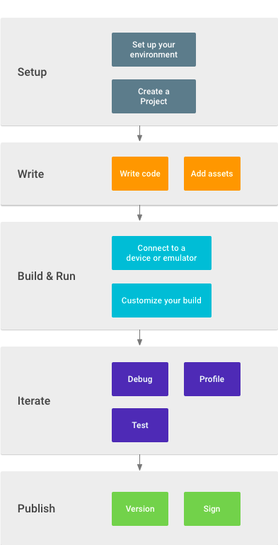
Workflow
-> Install Android Studio(IDE) and create a project.
-> Write quality code, design a UI and create resources for different device types.
-> Build the project into a debuggable APK package, that can be installed and run on Android-powered devices or an emulator.
-> Create tests to eliminate bugs and optimize app’s performance.
-> Publish when the app is ready to be released to the users. Versioning and signing it with a key is to be considered.

Slide 9
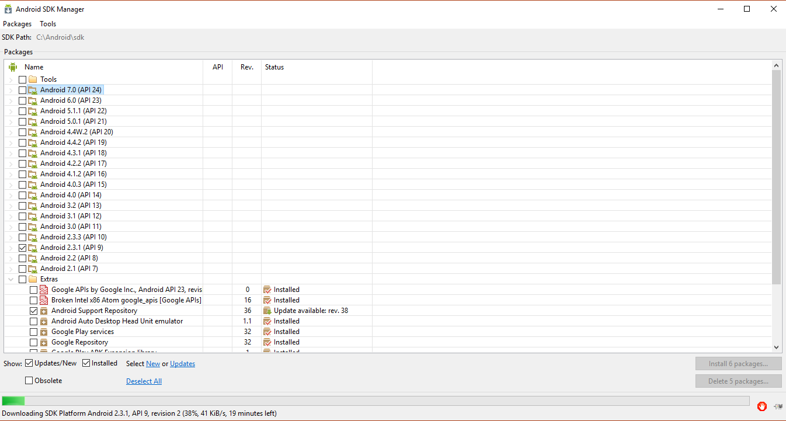
Android SDK Manager:

Slide 10
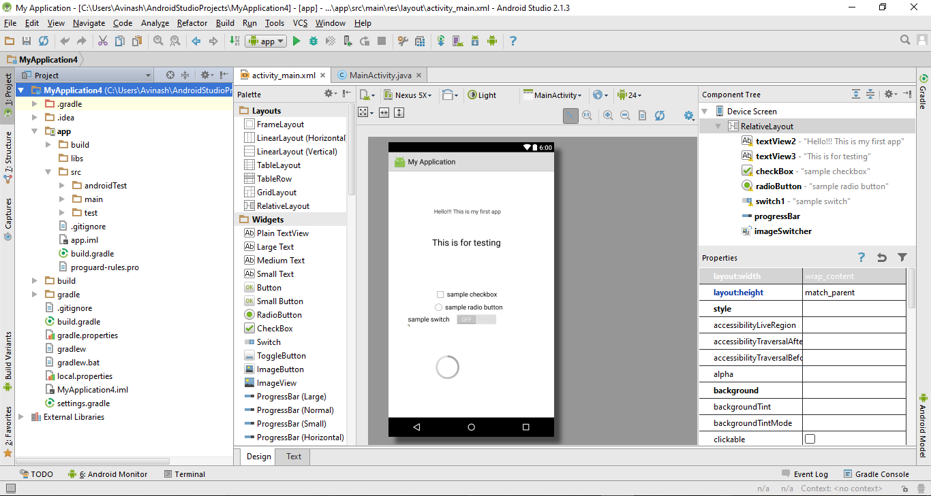
Sample Android Studio Workspace

Slide 11
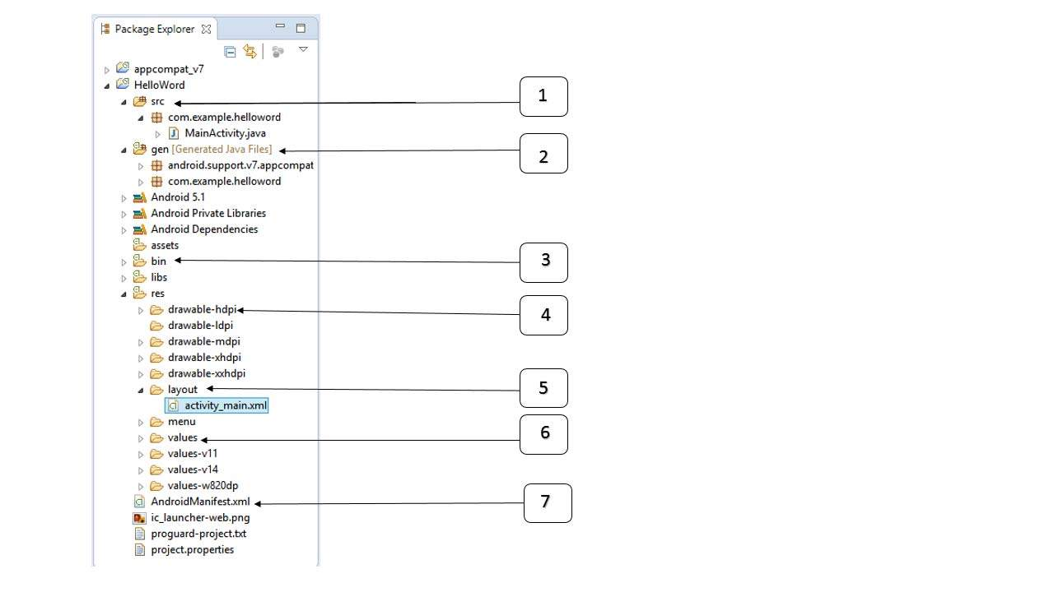
Anatomy of an Android Application
Src : This contains the.java source files
Gen : This contains the compiler-generated
.R file
Bin : This folder contains the .apk files
res/drawable-hdpi : drawable objects,
For High Density screens
res/layout : contains app’s user interface files
res/values : contains xml files for resouces,
ex strings
AndroidManifest.xml : describes the
Fundamental characteristics of the app

Slide 12
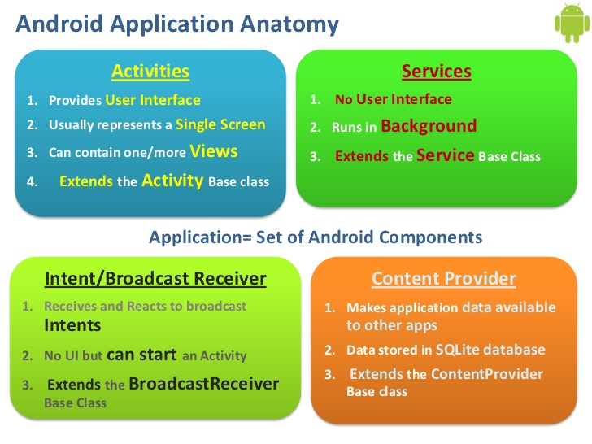
Components that MUST be present in an app
-> Activity
-> Intent
-> Interface
Components that CAN be present in an app
-> Services
-> Broadcast Receivers

Slide 13
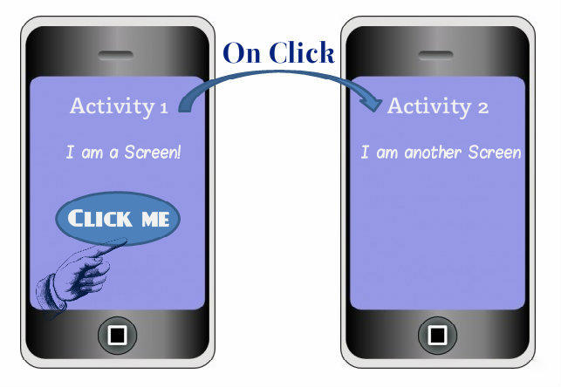
Activity
-> Activity provides the user a screen/interface to interact with the application.
-> An application typically has multiple activities. Each screen of an application is a different activity. We can understand this using the image shown. The first Activity (screen) has a button, which when clicked leads the user to a second screen, which is the second activity.

Slide 14
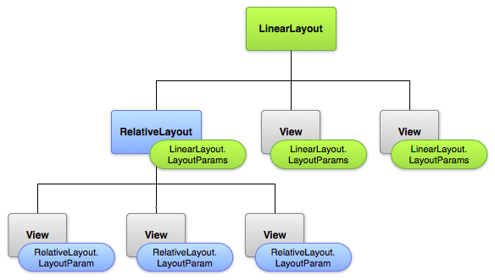
Layouts
A layout defines the visual structure for a user interface, such as the UI for an activity or app widget.
We can declare a layout in two ways:
Declare UI elements in XML. Android provides a straightforward XML vocabulary that corresponds to the View classes and subclasses, such as those for widgets and layouts.
Instantiate layout elements at runtime.
Layout options
1. Linear Layout
2. Relative Layout
3. Table Layout
4. Absolute Layout
5. Frame Layout
6. List View
7. Grid View

Slide 15
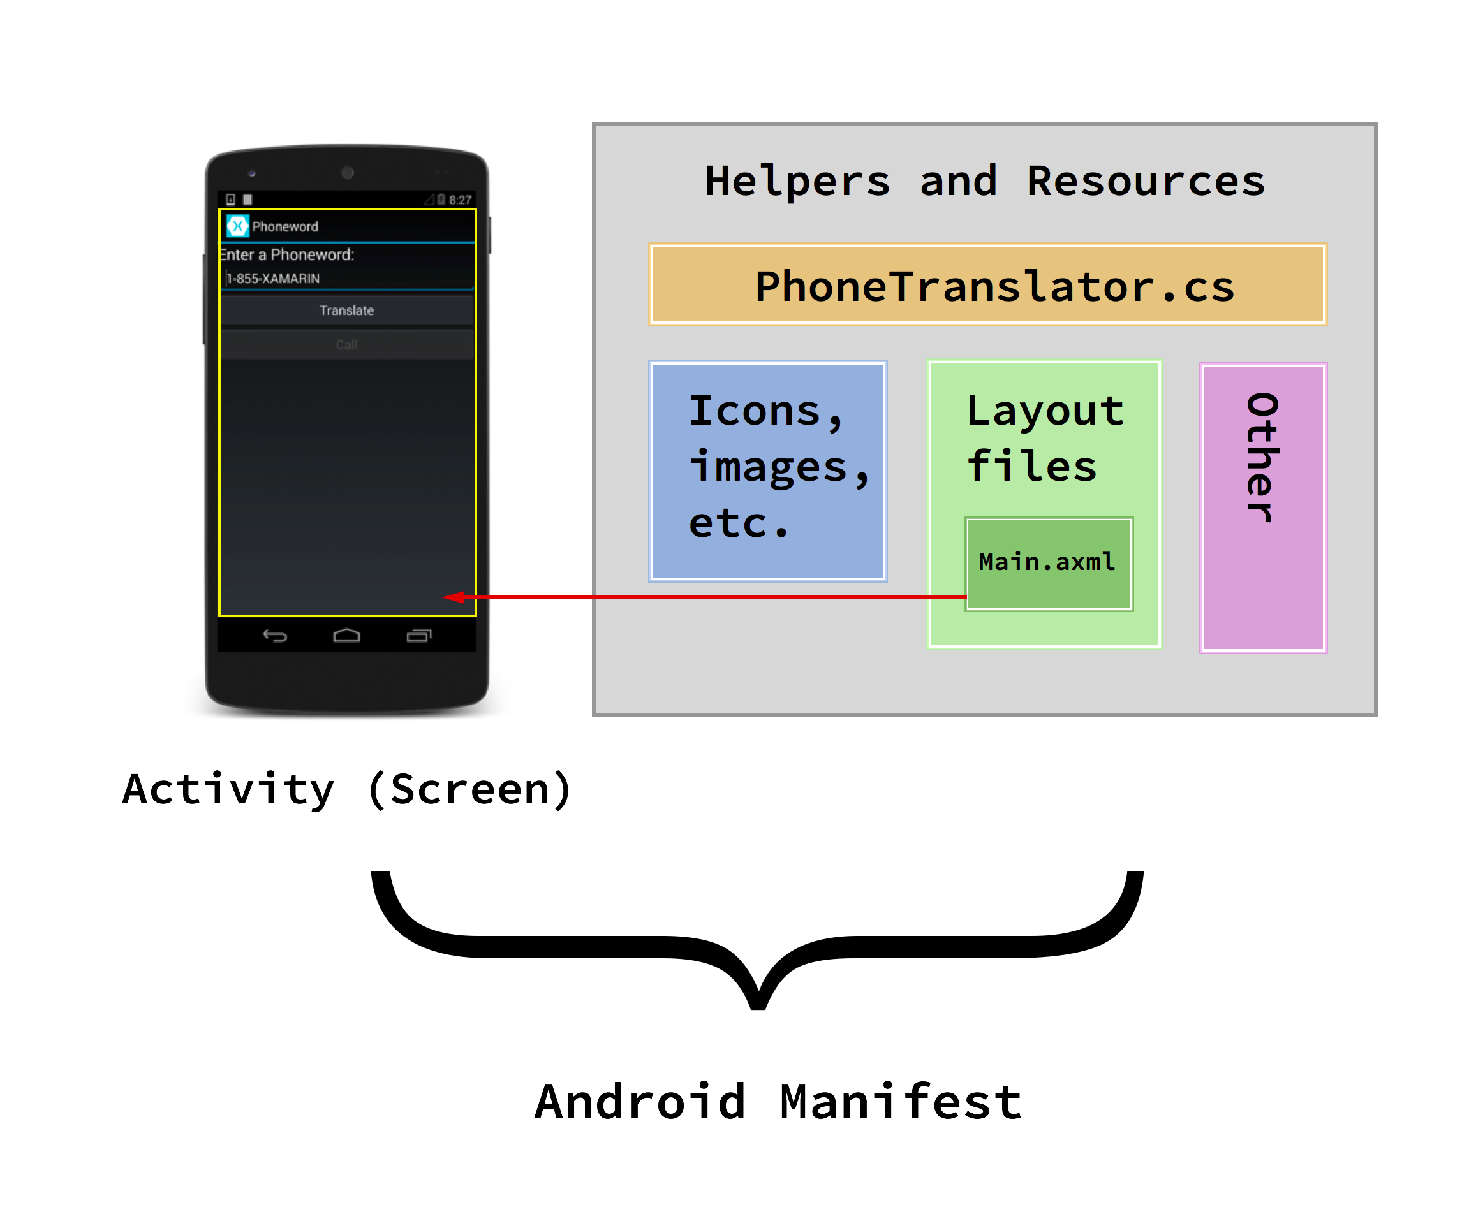
App Manifest
Every application must have an AndroidManifest.xml file (with precisely that name) in its root directory. The manifest file provides essential information about your app to the Android system, which the system must have before it can run any of the app's code.
It declares the permissions that the application must have in order to access protected parts of the API and interact with other applications. It also declares the permissions that others are required to have in order to interact with the application's components.

Slide 16
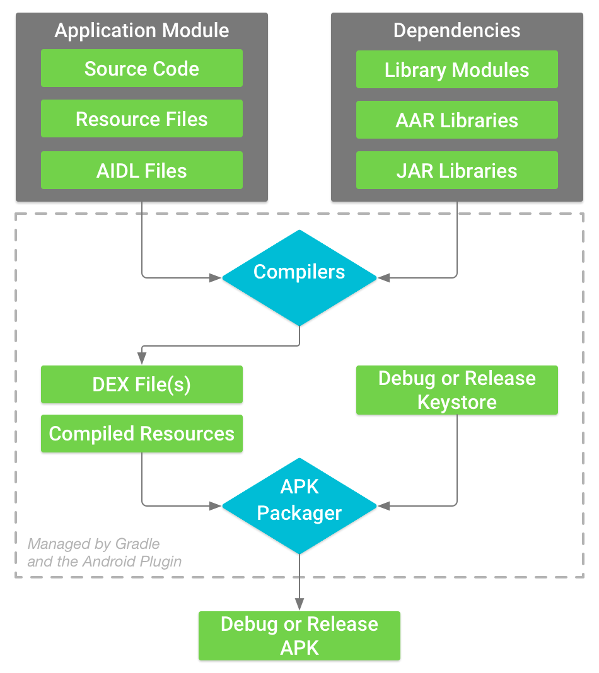
Generating the debug/release .apk file
1. Compiler converts the source code into DEX files, including the bytecode.
2. The APK Packager combines DEX files and compiled resources into single APK. APK must be signed before deployment.
3. The APK packager signs the APK using either the debug or release keystore.
4. At the end of the build process, you have either a debug APK or release APK of your app that you can use to deploy, test, or release to external users.

Slide 17
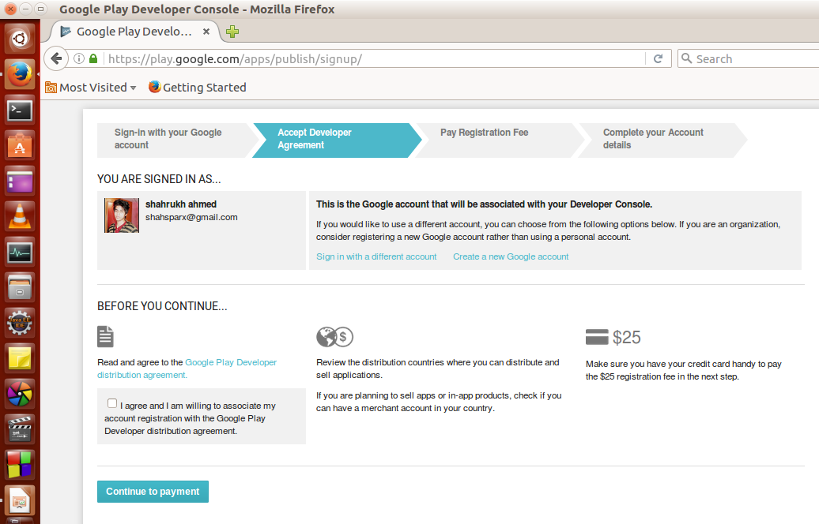
Publishing the app to Google Playstore

Slide 18
References
https://developer.android.com/
http://www.tutoriaspoint.com/android/
http://www.edureka.co/android-development-certification-course
https://play.google.com/apps/publish/signup/
http://www.forbes.com/sites/greatspeculations/2015/07/14/reasons-why-nokia-may-be-planning-to-re-enter-the-smartphone-business/#6b67c2d24869
http://www.slideshare.net/Besk/android-application-development-4402198
https://play.google.com/store/apps/top?hl=en

Slide 19


